Slide 1
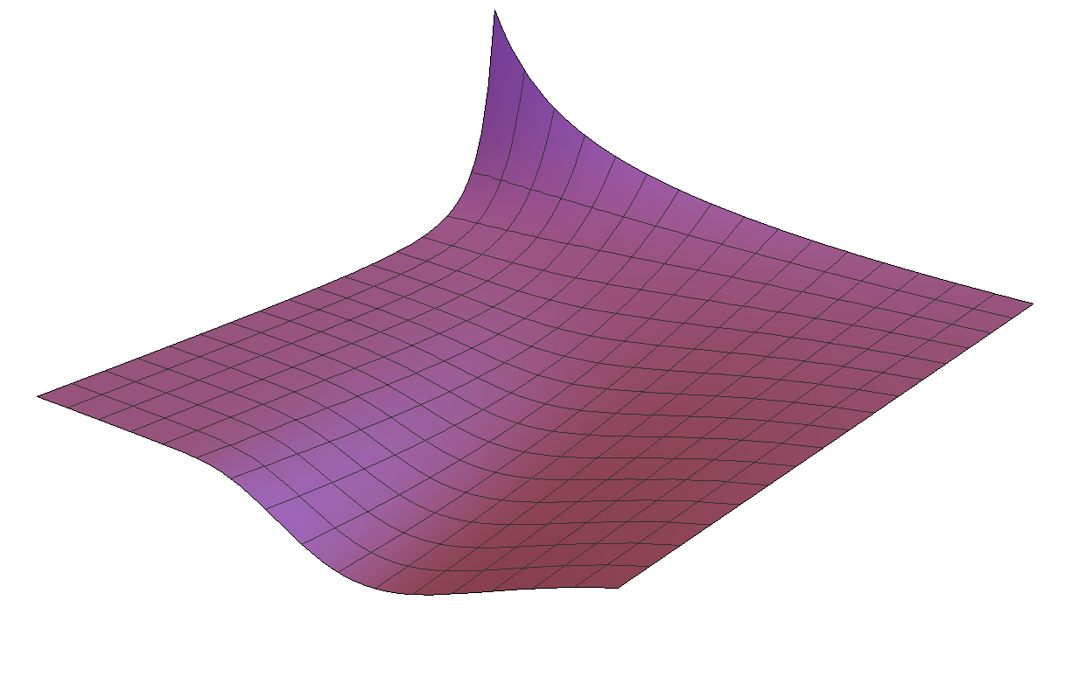
Fractional Differential Equations
Adam J. Gray
Supervised By: Dr Chris Tisdell
Never Stand Still
Faculty of Science
Mathematics and Statistics

Slide 2
Overview
What is fractional calculus?
How to solve a simple linear fractional differential equation.
Can we say anything about existence and uniqueness of solutions?
A brief on numerical solution methods.

Slide 3
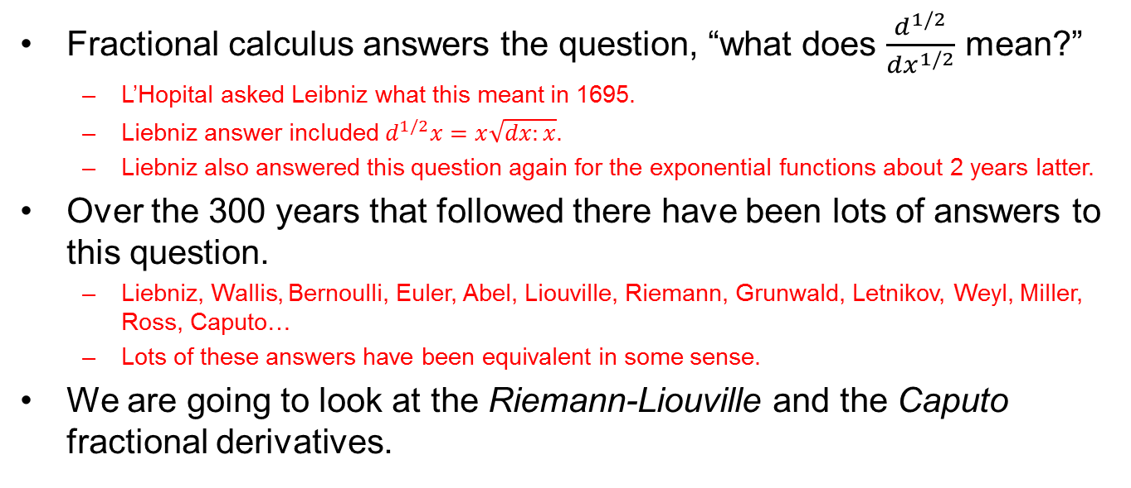
What is fractional calculus?
Fractional calculus answers the question, “what does $\frac{d^{1/2}}{dx^{1/2}}$ mean?”
L’Hopital asked Leibniz what this meant in 1695.
Liebniz answer included $d^{1/2}x=x\sqrt{dx:x}$.
Liebniz also answered this question again for the exponential functions about 2 years latter.
Over the 300 years that followed there have been lots of answers to this question.
Liebniz, Wallis, Bernoulli, Euler, Abel, Liouville, Riemann, Grunwald, Letnikov, Weyl, Miller, Ross, Caputo…
Lots of these answers have been equivalent in some sense.
We are going to look at the Riemann-Liouville and the Caputo fractional derivatives.

Slide 4
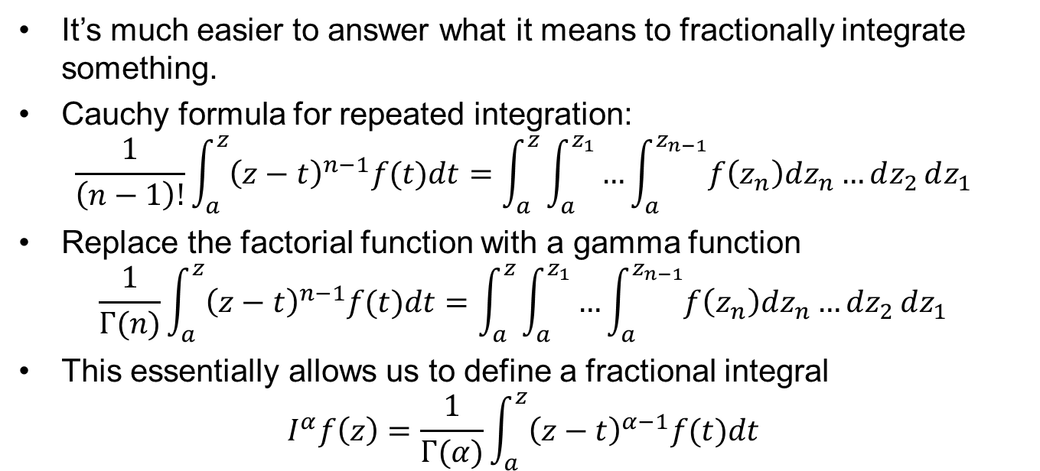
Riemann-Liouville
It’s much easier to answer what it means to fractionally integrate something.
Cauchy formula for repeated integration:
$$\frac{1}{\left(n−1\right)!}\int_{a}^{z}{{\left(z−t\right)}^{n−1}f(t)dt}=\int_{a}^{z}{\int_{a}^{z_{1}}{…\int_{a}^{z_{n−1}}{f\left(z_{n}\right)dz_{n}…}dz_{2}}dz_{1}}$$
Replace the factorial function with a gamma function
$$\frac{1}{Γ(n)}\int_{a}^{z}{{\left(z−t\right)}^{n−1}f(t)dt}=\int_{a}^{z}{\int_{a}^{z_{1}}{…\int_{a}^{z_{n−1}}{f\left(z_{n}\right)dz_{n}…}dz_{2}}dz_{1}}$$
This essentially allows us to define a fractional integral
$$I^{α}f\left(z\right)=\frac{1}{Γ(α)}\int_{a}^{z}{{\left(z−t\right)}^{α−1}f(t)dt}$$

Slide 5
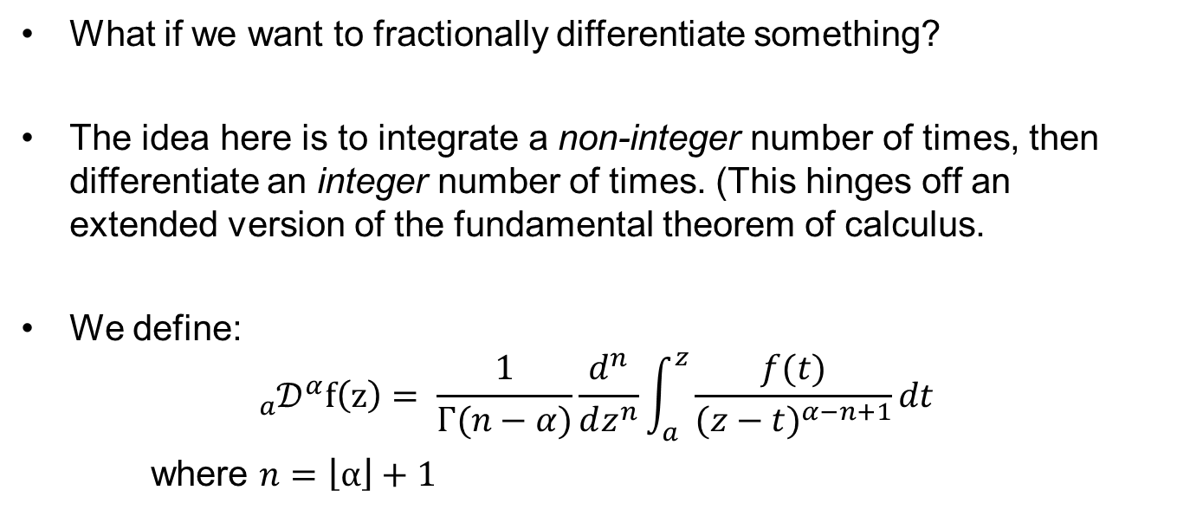
Riemann-Liouville continued…
What if we want to fractionally differentiate something?
The idea here is to integrate a non-integer number of times, then differentiate an integer number of times. (This hinges off an extended version of the fundamental theorem of calculus.
We define:
$${{}_{a}^{}𝒟}^{α}f\left(z\right)= \frac{1}{Γ(n−α)}\frac{d^{n}}{dz^{n}}\int_{a}^{z}{\frac{f(t)}{{(z−t)}^{α−n+1}}dt}$$
where $n=\left\lfloor α\right\rfloor +1$

Slide 6
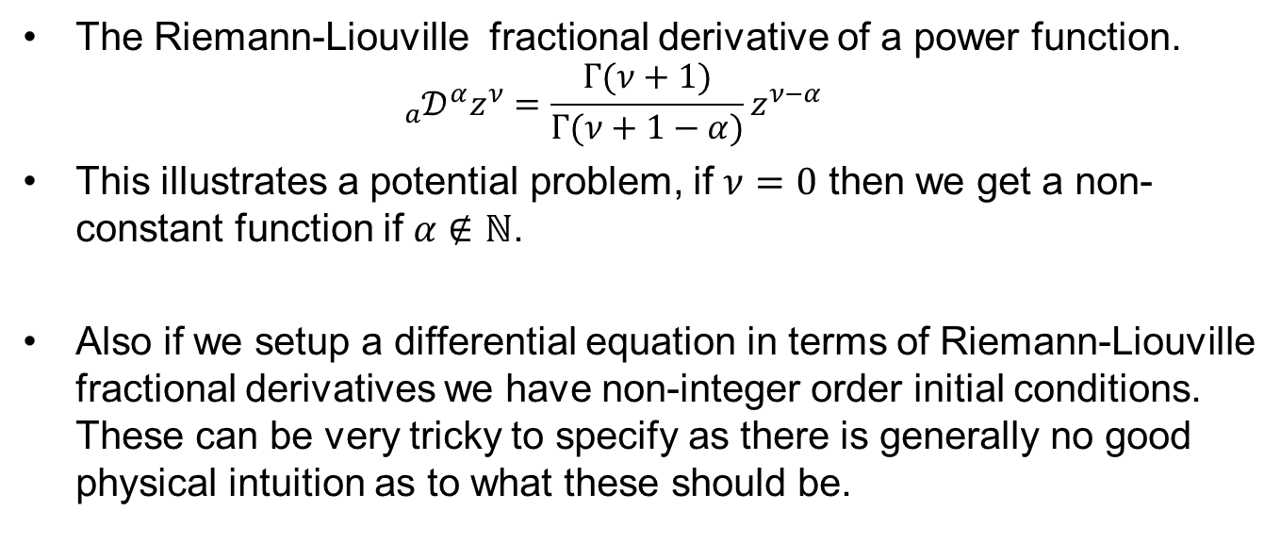
Riemann-Liouville continued…
The Riemann-Liouville fractional derivative of a power function.
$${{}_{a}^{}𝒟}^{α}z^{ν}=\frac{Γ(ν+1)}{Γ(ν+1−α)}z^{ν−α}$$
This illustrates a potential problem, if $ν=0$ then we get a non-constant function if $α∉ℕ$.
Also if we setup a differential equation in terms of Riemann-Liouville fractional derivatives we have non-integer order initial conditions. These can be very tricky to specify as there is generally no good physical intuition as to what these should be.

Slide 7
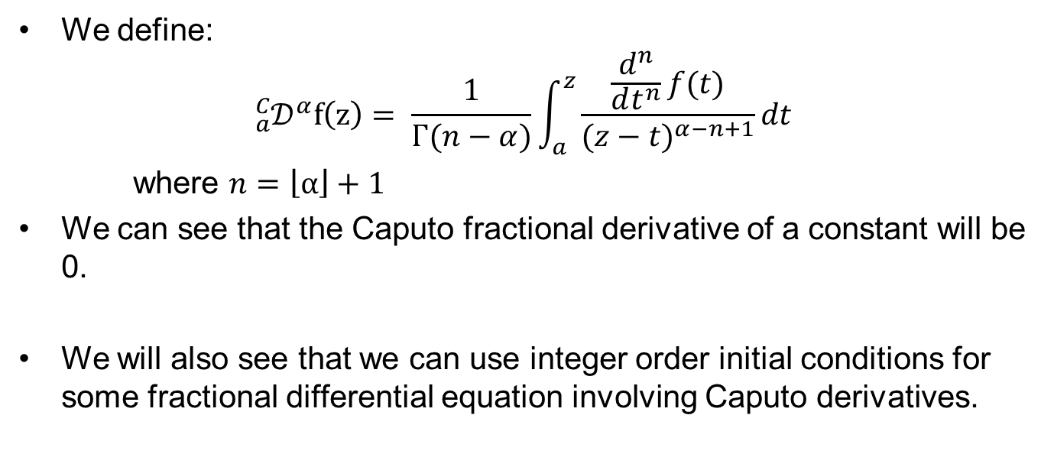
Caputo
We define:
$${{}_{a}^{C}𝒟}^{α}f\left(z\right)= \frac{1}{Γ(n−α)}\int_{a}^{z}{\frac{\frac{d^{n}}{dt^{n}}f(t)}{{(z−t)}^{α−n+1}}dt}$$
where $n=\left\lfloor α\right\rfloor +1$
We can see that the Caputo fractional derivative of a constant will be 0.
We will also see that we can use integer order initial conditions for some fractional differential equation involving Caputo derivatives.

Slide 8
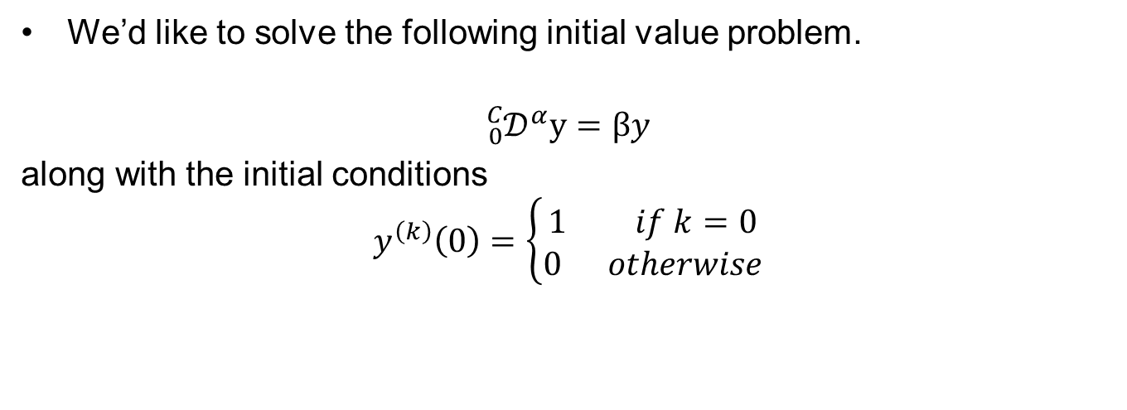
Linear Ordinary Fractional Differential Equation
We’d like to solve the following initial value problem.
$${{}_{0}^{C}𝒟}^{α}y=βy$$
along with the initial conditions
$$y^{\left(k\right)}\left(0\right)=\left\{\begin{aligned}1 if k=0 \\ 0 otherwise\end{aligned}\right.$$

Slide 9
Linear Ordinary Fractional Differential Equation Continued…
These problems are much easier to solve in Laplace space, than they are by manually evaluating and manipulating the integrals.
In fact many results in fractional calculus which would otherwise require 3 – 4 page proofs can be proved in just 5-6 lines in Laplace space.
We will have to introduce a collection of new ideas to solve the IVP.

Slide 10
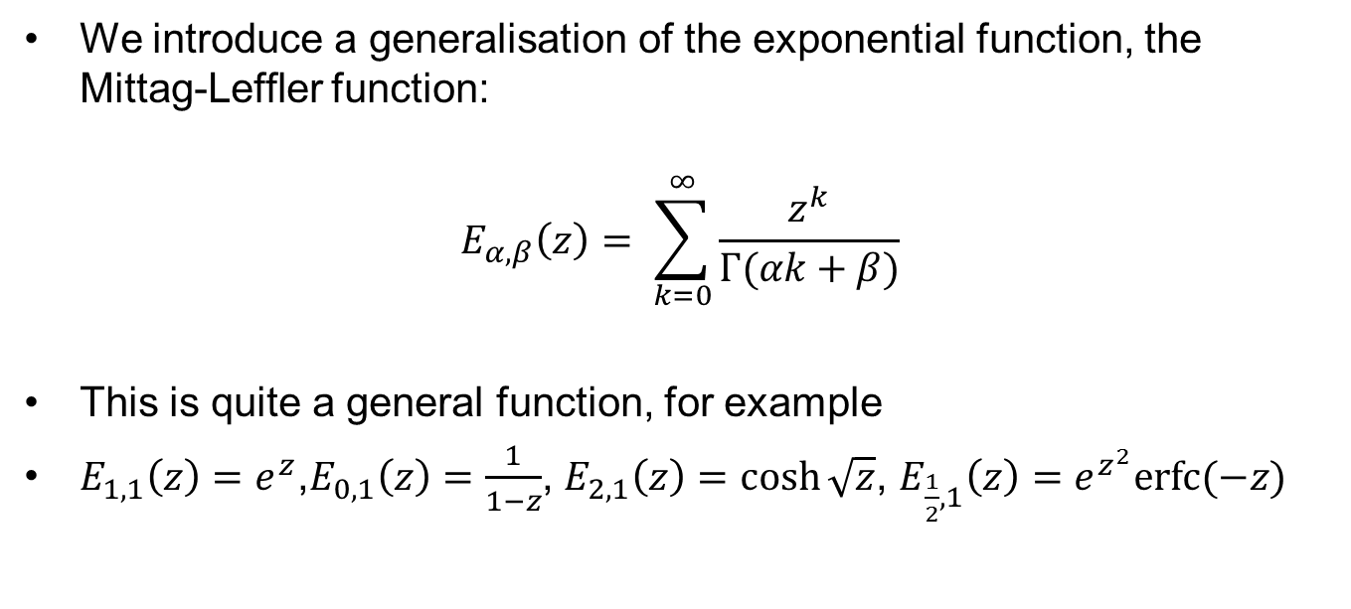
Mittag-Leffler Function
We introduce a generalisation of the exponential function, the Mittag-Leffler function:
$$E_{α,β}\left(z\right)= \sum_{k=0}^{∞}{\frac{z^{k}}{Γ(αk+β)}}$$
This is quite a general function, for example
$E_{1,1}\left(z\right)=e^{z}$,$E_{0,1}\left(z\right)=\frac{1}{1−z}$, $E_{2,1}\left(z\right)=\cosh{\sqrt{z}}$, $E_{\frac{1}{2},1}\left(z\right)=e^{z^{2}}erfc⁡(−z)$

Slide 11
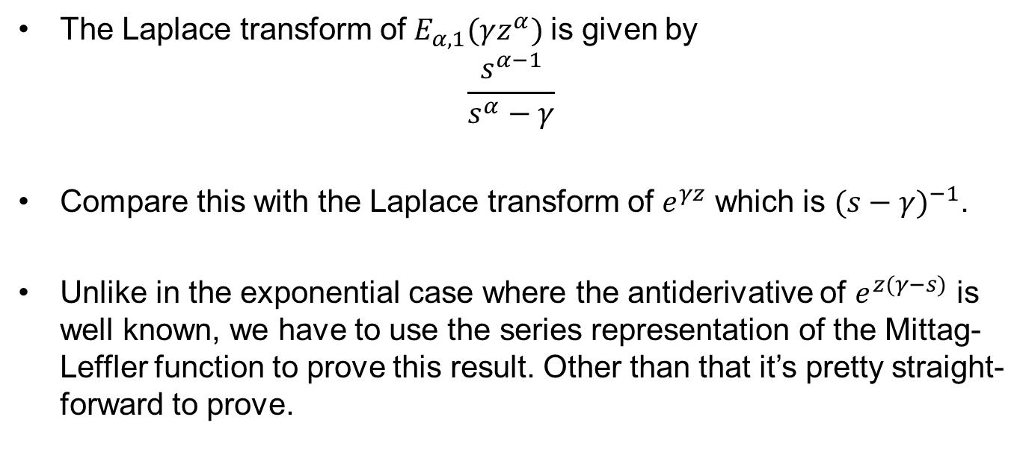
Mittag-Leffler Function continued…
The Laplace transform of$E_{α,1}(γz^{α})$ is given by
$$\frac{s^{α−1}}{s^{α}−γ}$$
Compare this with the Laplace transform of $e^{γz}$ which is ${(s−γ)}^{−1}$.
Unlike in the exponential case where the antiderivative of $e^{z(γ−s)}$ is well known, we have to use the series representation of the Mittag-Leffler function to prove this result. Other than that it’s pretty straight-forward to prove.

Slide 12
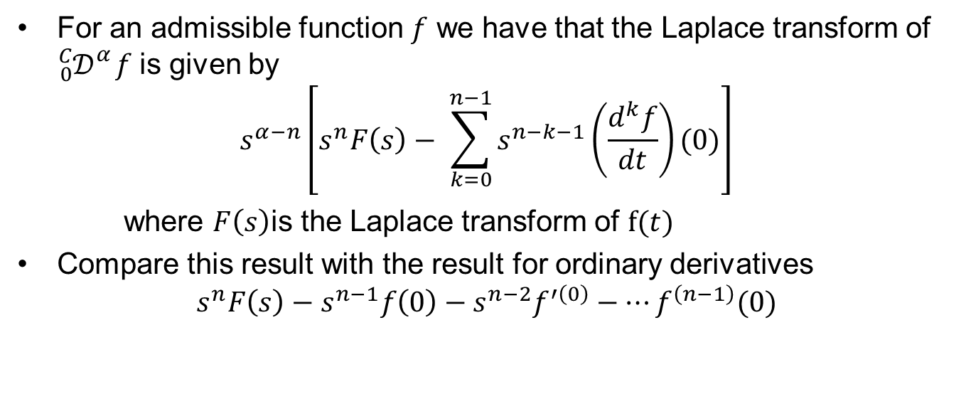
Laplace Transform of Caputo Derivative
For an admissible function $f$ we have that the Laplace transform of ${}_{0}^{C}{𝒟_{}^{α}f}$ is given by
$$s^{α−n}\left[s^{n}F\left(s\right)− \sum_{k=0}^{n−1}{s^{n−k−1}\left(\frac{d^{k}f}{dt}\right)(0)}\right]$$
where $F\left(s\right)$is the Laplace transform of $f(t)$
Compare this result with the result for ordinary derivatives
$$s^{n}F\left(s\right)−s^{n−1}f\left(0\right)−s^{n−2}f^{′\left(0\right)}−…f^{\left(n−1\right)}(0)$$

Slide 13
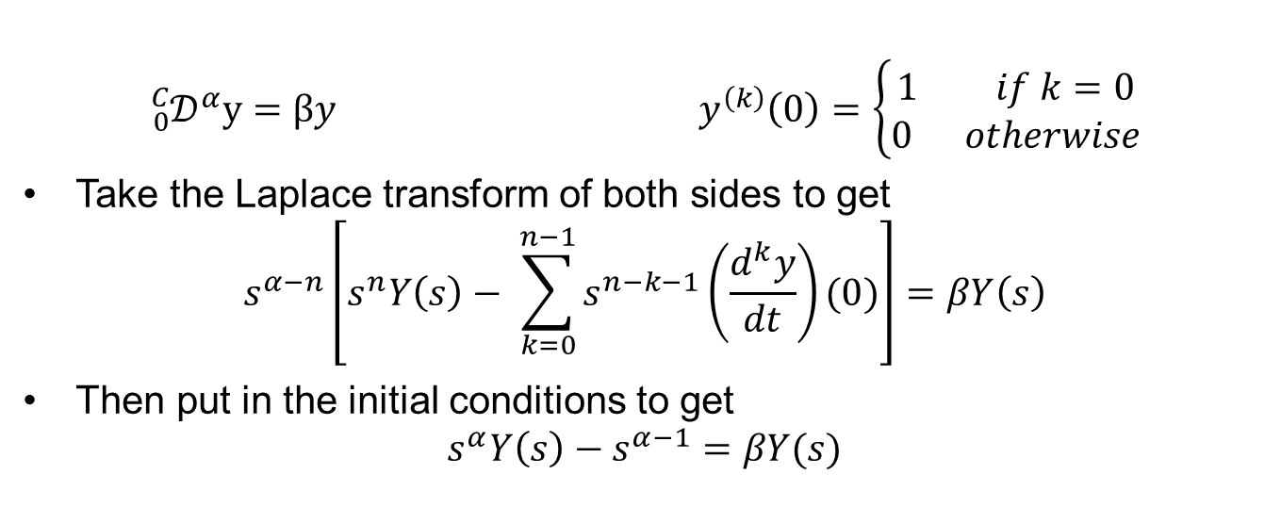
Linear Ordinary Fractional Differential Equation - Solution
$${{}_{0}^{C}𝒟}^{α}y=βy y^{\left(k\right)}\left(0\right)=\left\{\begin{aligned}1 if k=0 \\ 0 otherwise\end{aligned}\right.$$
Take the Laplace transform of both sides to get
$$s^{α−n}\left[s^{n}Y\left(s\right)− \sum_{k=0}^{n−1}{s^{n−k−1}\left(\frac{d^{k}y}{dt}\right)(0)}\right]=βY\left(s\right)$$
Then put in the initial conditions to get
$$s^{α}Y\left(s\right)−s^{α−1}=βY(s)$$

Slide 14
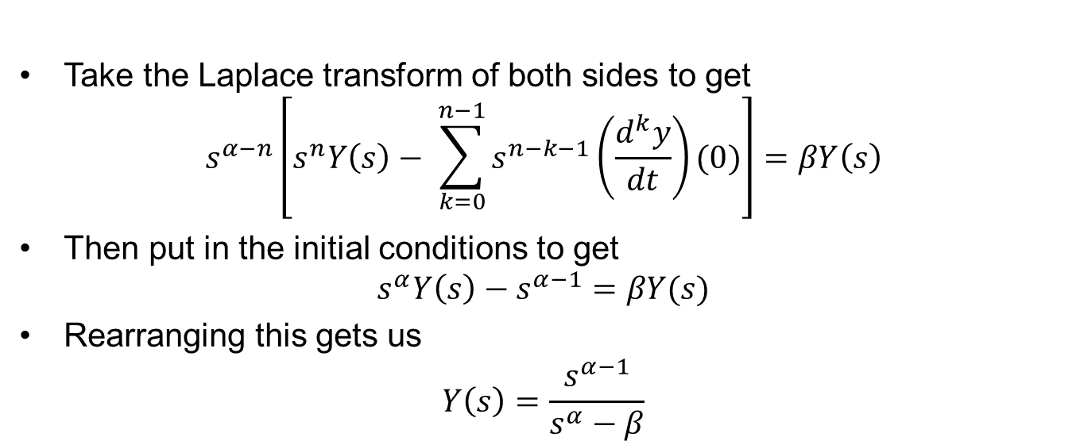
Linear Ordinary Fractional Differential Equation - Solution
Take the Laplace transform of both sides to get
$$s^{α−n}\left[s^{n}Y\left(s\right)− \sum_{k=0}^{n−1}{s^{n−k−1}\left(\frac{d^{k}y}{dt}\right)(0)}\right]=βY\left(s\right)$$
Then put in the initial conditions to get
$$s^{α}Y\left(s\right)−s^{α−1}=βY(s)$$
Rearranging this gets us
$$Y\left(s\right)=\frac{s^{α−1}}{s^{α}−β}$$

Slide 15
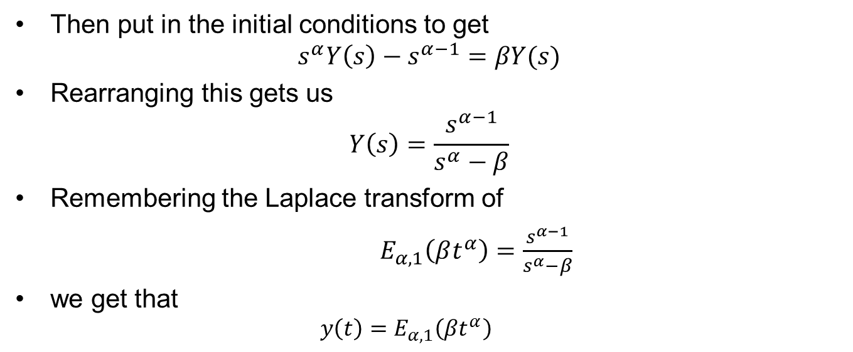
Linear Ordinary Fractional Differential Equation - Solution
Then put in the initial conditions to get
$$s^{α}Y\left(s\right)−s^{α−1}=βY(s)$$
Rearranging this gets us
$$Y\left(s\right)=\frac{s^{α−1}}{s^{α}−β}$$
Remembering the Laplace transform of
$E_{α,1}\left(βt^{α}\right)=\frac{s^{α−1}}{s^{α}−β}$
we get that
$$y\left(t\right)=E_{α,1}\left(βt^{α}\right)$$

Slide 16
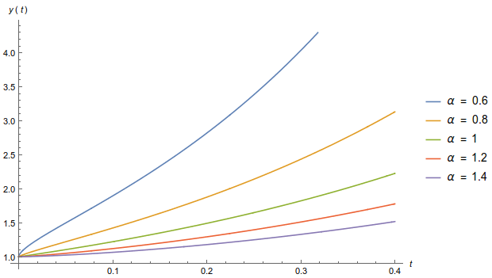
Solution Plots

Slide 17
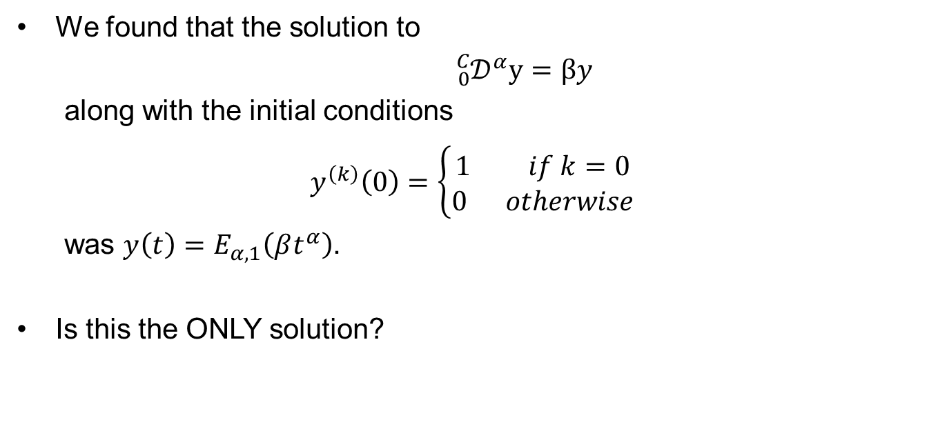
Uniqueness
We found that the solution to
${{}_{0}^{C}𝒟}^{α}y=βy$
along with the initial conditions
$y^{\left(k\right)}\left(0\right)=\left\{\begin{aligned}1 if k=0 \\ 0 otherwise\end{aligned}\right.$
was $y\left(t\right)=E_{α,1}\left(βt^{α}\right)$.
Is this the ONLY solution?

Slide 18
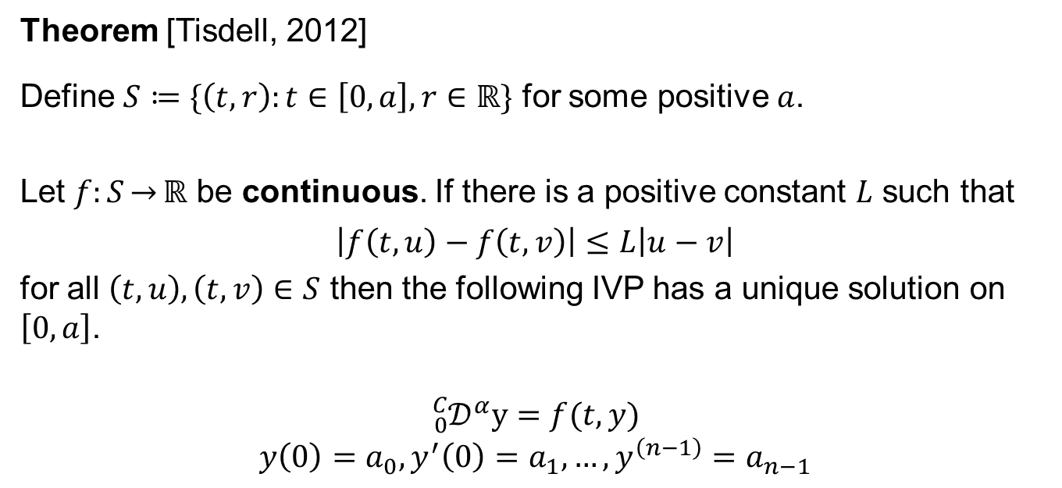
Uniqueness – Some Theorems
Theorem [Tisdell, 2012]
Define $S≔\{\left(t,r\right):t∈\left[0,a\right],r∈ℝ\}$ for some positive $a$.
Let $f:S\overset{→}{}ℝ$ be continuous. If there is a positive constant $L$ such that
$$\left|f\left(t,u\right)−f\left(t,v\right)\right|≤L\left|u−v\right|$$
for all $\left(t,u\right),\left(t,v\right)∈S$ then the following IVP has a unique solution on $\left[0,a\right]$.
$${{}_{0}^{C}𝒟}^{α}y=f(t,y)$$
$$y\left(0\right)=a_{0},y^{′}\left(0\right)=a_{1},…,y^{\left(n−1\right)}=a_{n−1}$$

Slide 19
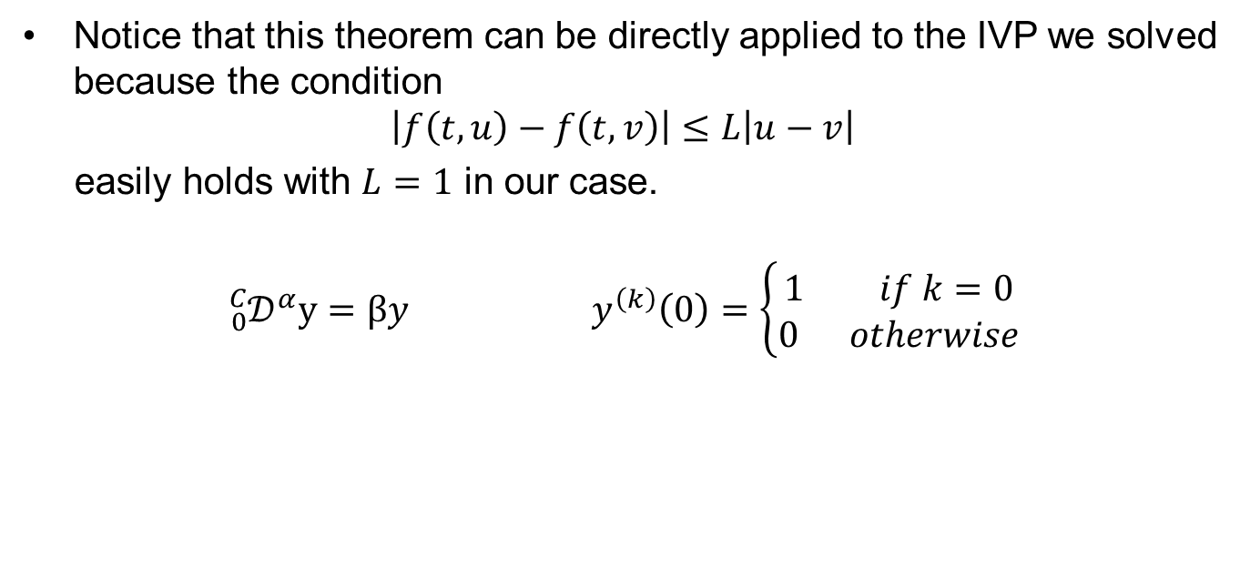
Uniqueness – Some Theorems
Notice that this theorem can be directly applied to the IVP we solved because the condition
$$\left|f\left(t,u\right)−f\left(t,v\right)\right|≤L\left|u−v\right|$$
easily holds with $L=1$ in our case.
$${{}_{0}^{C}𝒟}^{α}y=βy y^{\left(k\right)}\left(0\right)=\left\{\begin{aligned}1 if k=0 \\ 0 otherwise\end{aligned}\right.$$

Slide 20
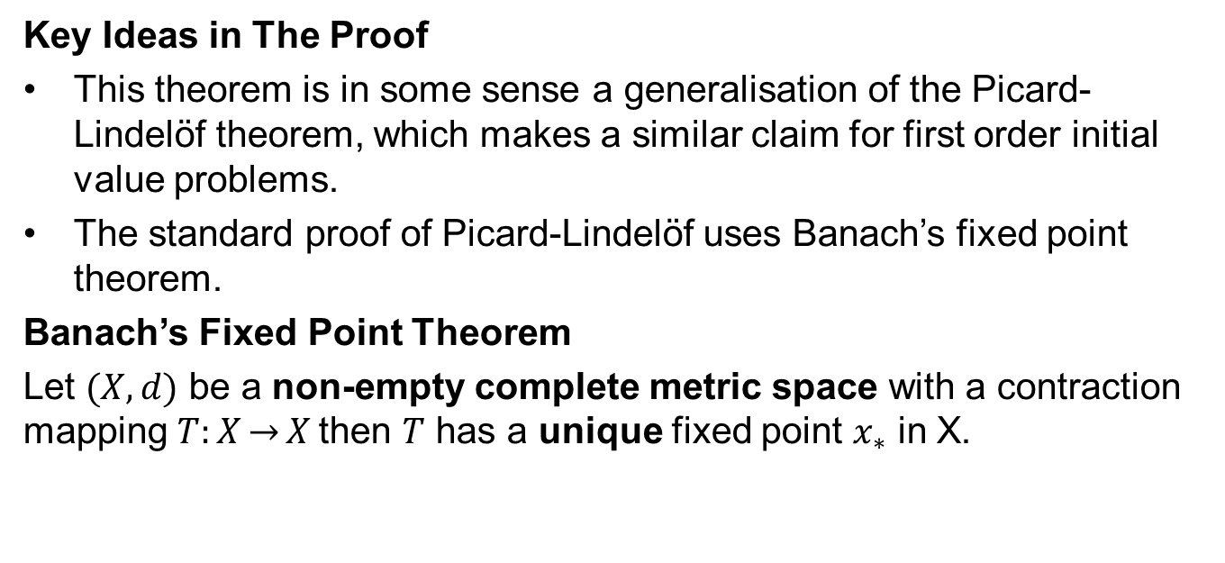
Uniqueness – Some Theorems
Key Ideas in The Proof
This theorem is in some sense a generalisation of the Picard-Lindelöf theorem, which makes a similar claim for first order initial value problems.
The standard proof of Picard-Lindelöf uses Banach’s fixed point theorem.
Banach’s Fixed Point Theorem
Let $(X,d)$ be a non-empty complete metric space with a contraction mapping $T:X\overset{→}{}X$then $T$ has a unique fixed point $x_{∗}$ in X.

Slide 21
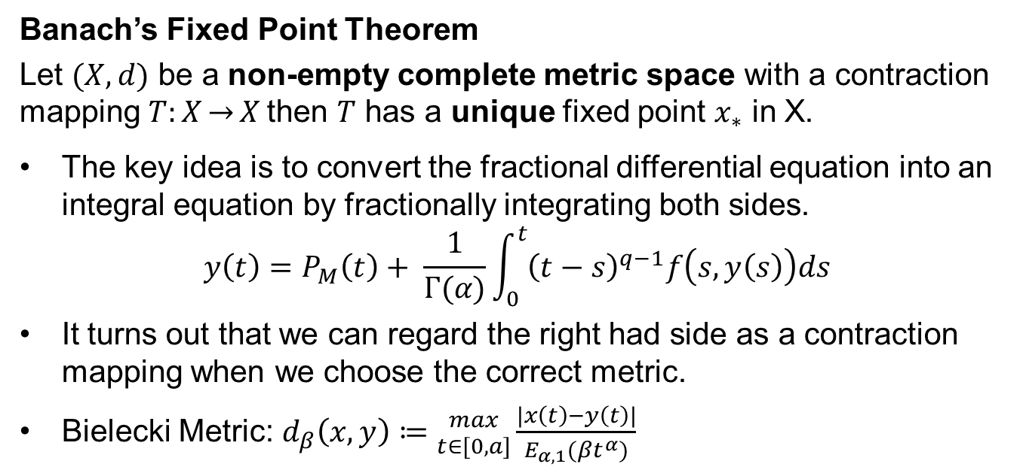
Uniqueness – Some Theorems
Banach’s Fixed Point Theorem
Let $(X,d)$ be a non-empty complete metric space with a contraction mapping $T:X\overset{→}{}X$then $T$ has a unique fixed point $x_{∗}$ in X.
The key idea is to convert the fractional differential equation into an integral equation by fractionally integrating both sides.
$$y\left(t\right)=P_{M}\left(t\right)+ \frac{1}{Γ(α)}\int_{0}^{t}{{\left(t−s\right)}^{q−1}f\left(s,y\left(s\right)\right)ds}$$
It turns out that we can regard the right had side as a contraction mapping when we choose the correct metric.
Bielecki Metric: $d_{β}\left(x,y\right)≔{max \atop t∈[0,a]}\frac{|x\left(t\right)−y\left(t\right)|}{E_{α,1}(βt^{α})}$

Slide 22
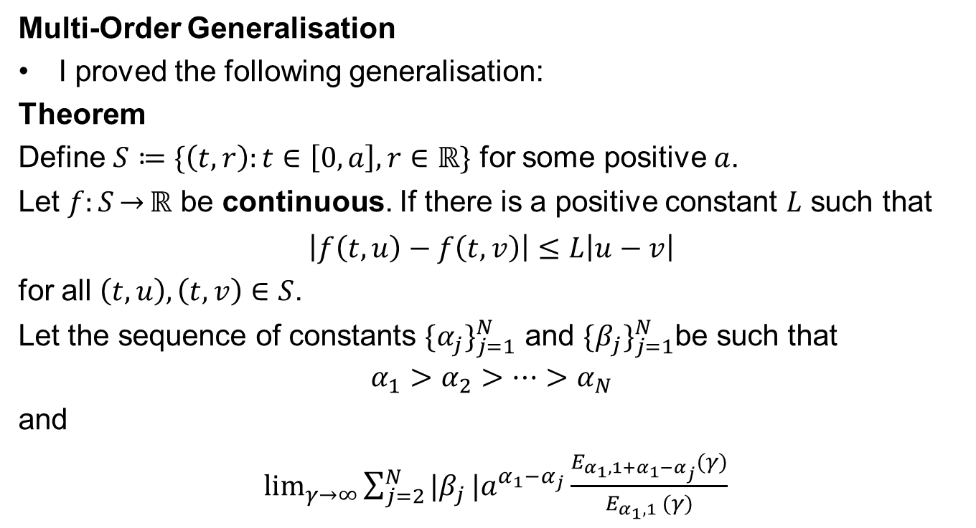
Uniqueness – Some Theorems
Multi-Order Generalisation
I proved the following generalisation:
Theorem
Define $S≔\{\left(t,r\right):t∈\left[0,a\right],r∈ℝ\}$ for some positive $a$.
Let $f:S\overset{→}{}ℝ$ be continuous. If there is a positive constant $L$ such that
$$\left|f\left(t,u\right)−f\left(t,v\right)\right|≤L\left|u−v\right|$$
for all $\left(t,u\right),\left(t,v\right)∈S$.
Let the sequence of constants $\{α_{j}\}_{j=1}^{N}$ and $\{β_{j}\}_{j=1}^{N}$be such that
$$α_{1}>α_{2}>…>α_{N}$$
and
$\lim_{γ\overset{→}{}∞}{\sum_{j=2}^{N}{|β_{j}}}|a^{α_{1}−α_{j}}\frac{E_{α_{1},1+α_{1}−α_{j}}(γ)}{E_{α_{1},1 }(γ)}$

Slide 23
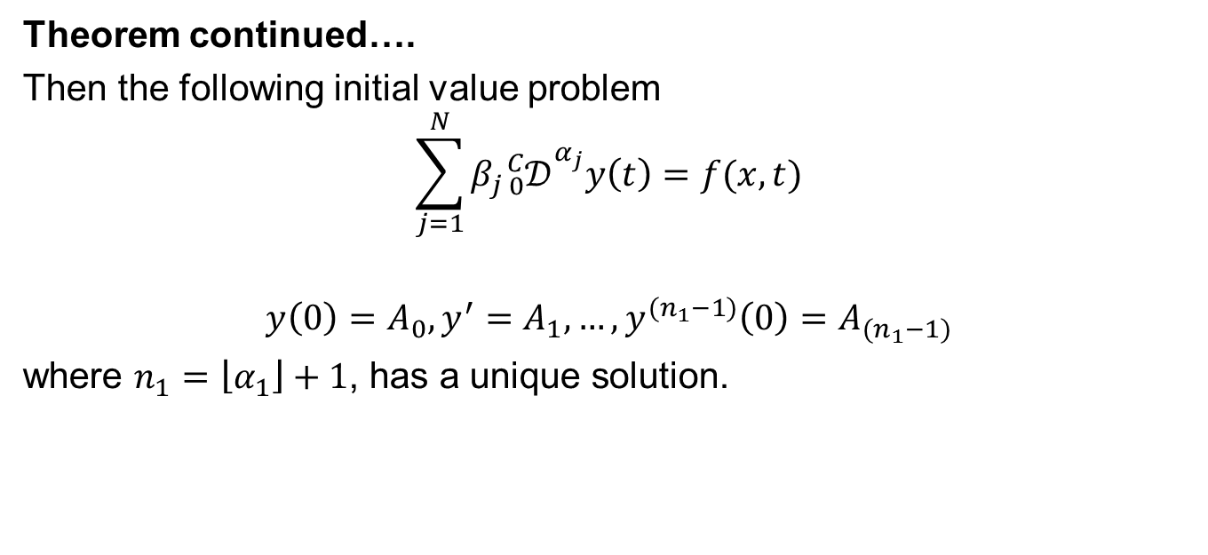
Uniqueness – Some Theorems
Theorem continued….
Then the following initial value problem
$$\sum_{j=1}^{N}{β_{j}{}_{0}^{C}{𝒟_{}^{α_{j}}y\left(t\right)=f(x,t)}}$$
$$y\left(0\right)=A_{0},y^{′}=A_{1}, …,y^{(n_{1}−1)}\left(0\right)=A_{(n_{1}−1)}$$
where $n_{1}=\left\lfloor α_{1}\right\rfloor +1$, has a unique solution.

Slide 24
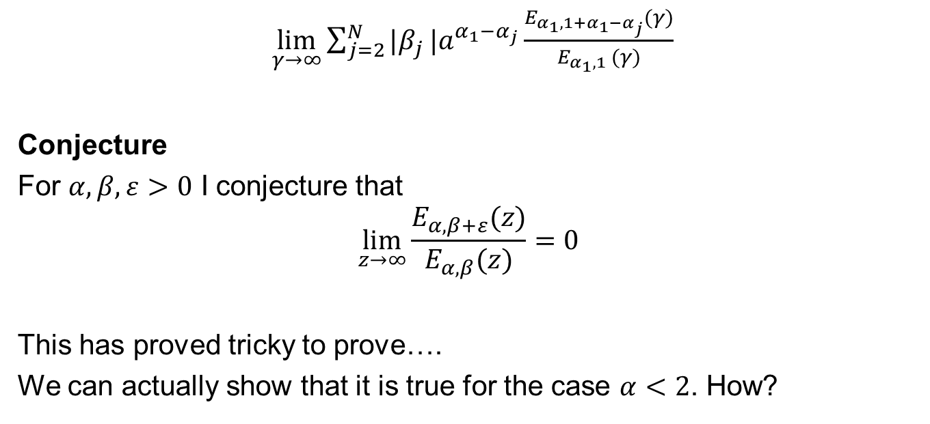
Uniqueness – Some Theorems
$\lim_{γ\overset{→}{}∞}{\sum_{j=2}^{N}{|β_{j}}}|a^{α_{1}−α_{j}}\frac{E_{α_{1},1+α_{1}−α_{j}}(γ)}{E_{α_{1},1 }(γ)}$
Conjecture
For $α,β,ε>0$ I conjecture that
$$\lim_{z\overset{→}{}∞}{\frac{E_{α,β+ε}(z)}{E_{α,β}(z)}=0}$$
This has proved tricky to prove….
We can actually show that it is true for the case $α<2$. How?

Slide 25
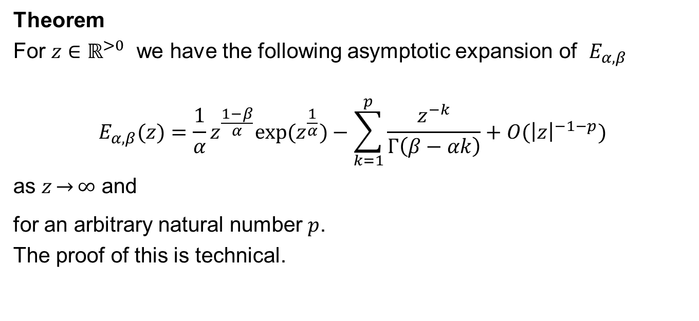
Asymptotic Expansion of $E_{α,β}$
Theorem
For $z∈ℝ^{>0}$ we have the following asymptotic expansion of $E_{α,β}$
$$E_{α,β}(z)=\frac{1}{α}z^{\frac{1−β}{α}}{exp⁡(z}^{\frac{1}{α}})−\sum_{k=1}^{p}{\frac{z^{−k}}{Γ\left(β−αk\right)}}+O({\left|z\right|}^{−1−p})$$
as $z\overset{→}{}∞$ and
for an arbitrary natural number $p$.
The proof of this is technical.

Slide 26
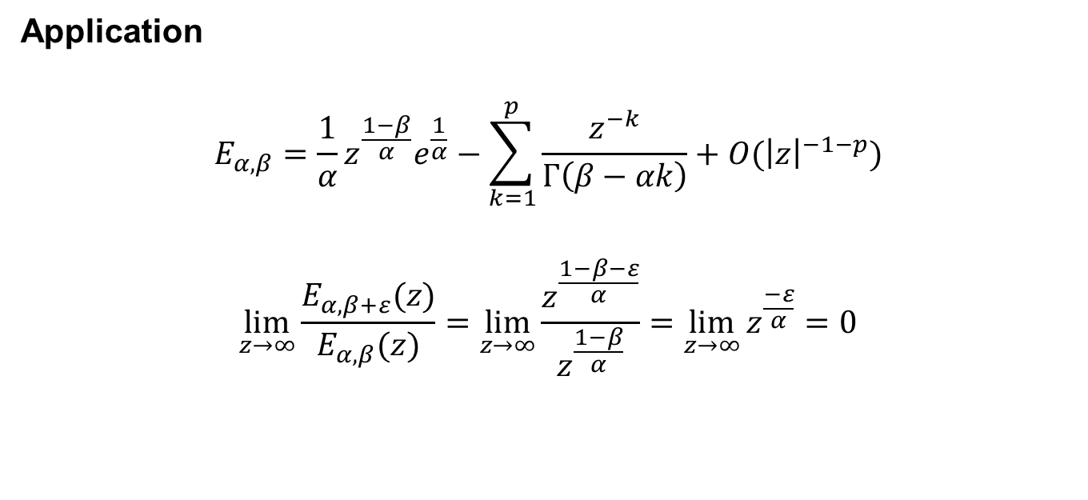
Asymptotic Expansion of $E_{α,β}$
Application
$$E_{α,β}=\frac{1}{α}z^{\frac{1−β}{α}}e^{\frac{1}{α}}−\sum_{k=1}^{p}{\frac{z^{−k}}{Γ\left(β−αk\right)}}+O({\left|z\right|}^{−1−p})$$
$$\lim_{z\overset{→}{}∞}{\frac{E_{α,β+ε}(z)}{E_{α,β}(z)}=\lim_{z\overset{→}{}∞}\frac{z^{\frac{1−β−ε}{α}}}{z^{\frac{1−β}{α}}}=\lim_{z\overset{→}{}∞}}z^{\frac{−ε}{α}}=0$$

Slide 27
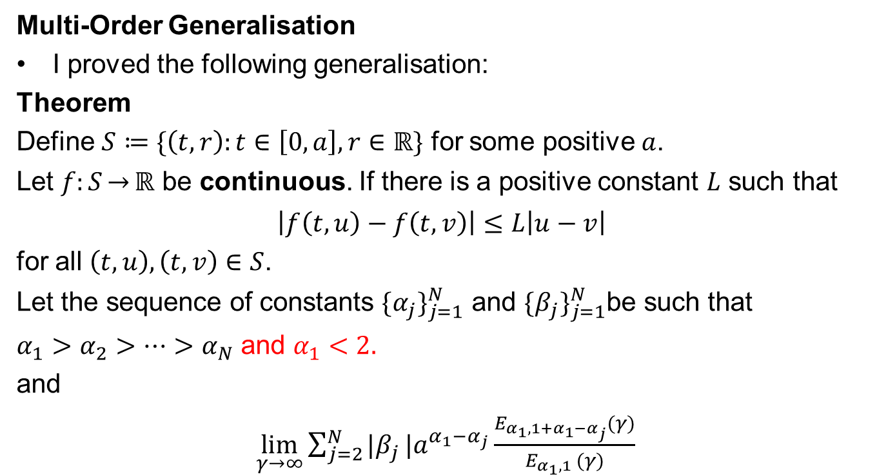
Uniqueness – Some Theorems
Multi-Order Generalisation
I proved the following generalisation:
Theorem
Define $S≔\{\left(t,r\right):t∈\left[0,a\right],r∈ℝ\}$ for some positive $a$.
Let $f:S\overset{→}{}ℝ$ be continuous. If there is a positive constant $L$ such that
$$\left|f\left(t,u\right)−f\left(t,v\right)\right|≤L\left|u−v\right|$$
for all $\left(t,u\right),\left(t,v\right)∈S$.
Let the sequence of constants $\{α_{j}\}_{j=1}^{N}$ and $\{β_{j}\}_{j=1}^{N}$be such that
$α_{1}>α_{2}>…>α_{N}$ and $α_{1}<2.$
and
$\lim_{γ\overset{→}{}∞}{\sum_{j=2}^{N}{|β_{j}}}|a^{α_{1}−α_{j}}\frac{E_{α_{1},1+α_{1}−α_{j}}(γ)}{E_{α_{1},1 }(γ)}$

Slide 28
Uniqueness – Some Theorems
Theorem continued….
Then the following initial value problem
$$\sum_{j=1}^{N}{β_{j}{}_{0}^{C}{𝒟_{}^{α_{j}}y\left(t\right)=f(x,t)}}$$
$$y\left(0\right)=A_{0},y^{′}=A_{1}, …,y^{(n_{1}−1)}\left(0\right)=A_{(n_{1}−1)}$$
where $n_{1}=\left\lfloor α_{1}\right\rfloor +1$, has a unique solution.

Slide 29
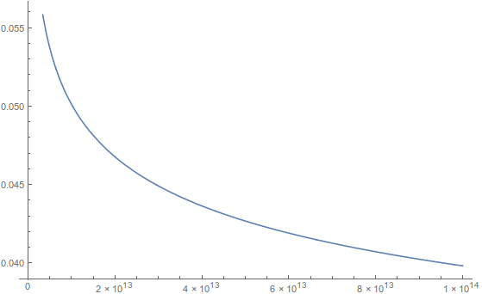

Some Big Numbers
$$α=β=1, ε=0.1$$

Slide 30
Successive Approximations
Several authors [Tisdell, Podlubny], talk about successive approximations.
Just like in the case of the Picard-Lindelöf theorem, the proof is constructive. That means that we can actually use the sequence generated by repeated application of the contraction mapping to approximate the solution in the neighbourhood of a point.
This isn’t an efficient numerical technique, but it is important from a theoretical perspective.

Slide 31
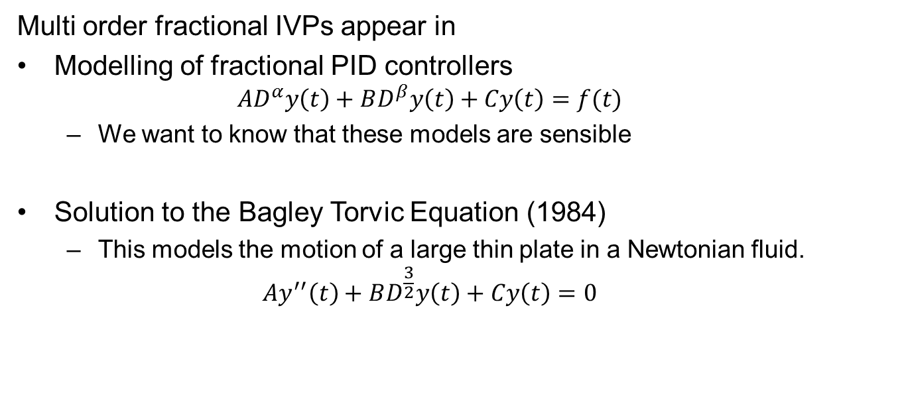
Why do we care?
Multi order fractional IVPs appear in
Modelling of fractional PID controllers
$${AD}^{α}y\left(t\right)+BD^{β}y\left(t\right)+Cy\left(t\right)=f(t)$$
We want to know that these models are sensible
Solution to the Bagley Torvic Equation (1984)
This models the motion of a large thin plate in a Newtonian fluid.
$$Ay^{′′}\left(t\right)+BD^{\frac{3}{2}}y\left(t\right)+Cy\left(t\right)=0$$

Slide 32
Numerical Solution Technique
Obviously not everything has a nice solution, like for the IVP we discussed before.
There are a variety of methods for numerically solving IVPs.
I looked at an Adam’s Moulton Bashforth method.
Integer order IVPs often have a solution method with O(n) computational complexity.
Fractional order IVPs often have a solution method with O(n²) computational complexity.

Slide 33
Numerical Solution Technique
Fractional order IVPs often have a solution method with O(n²) computational complexity.
This happens because of the non-local nature of fractional derivatives.
It opens up the opportunity to write parallel solution schemes.
Based off a paper by Diethelm I modified the a parallel scheme to get it to work on CUDA.
Running on my machine I got a roughly 600 fold speedup vs a 6 core hyper-threaded CPU.

Slide 34
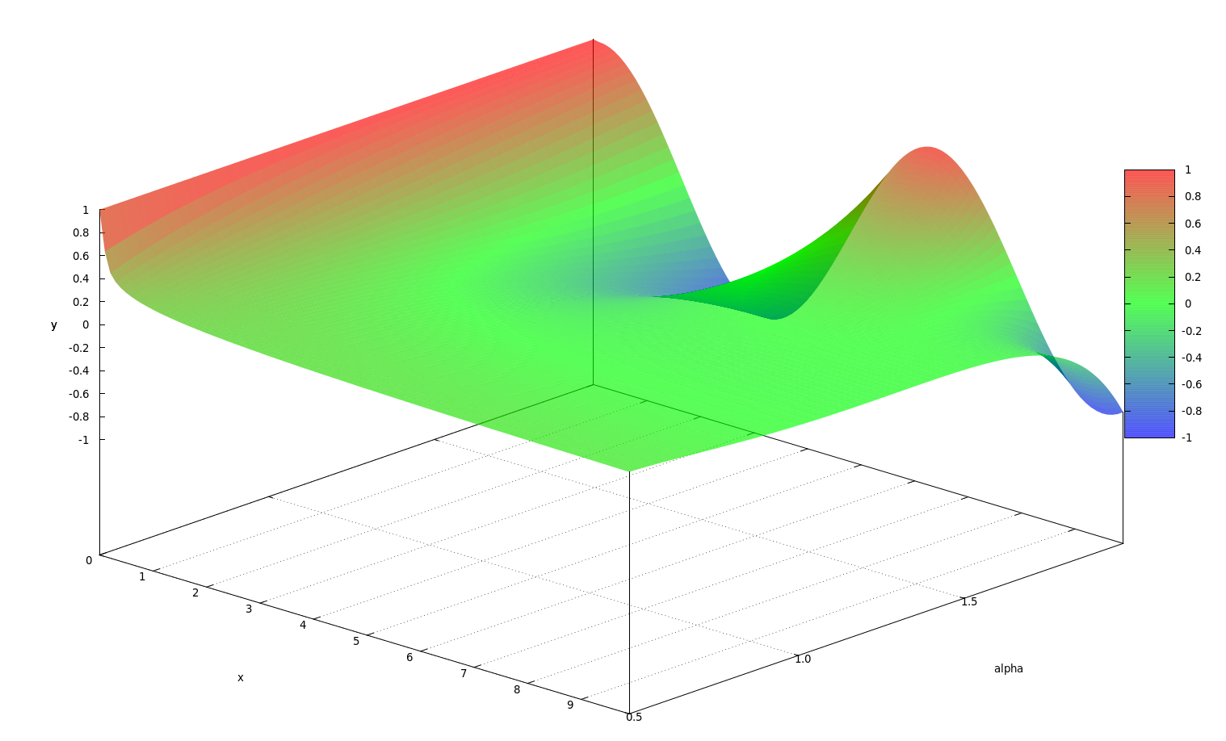
A Pretty Picture

Slide 35
Thankyou

Slide 36
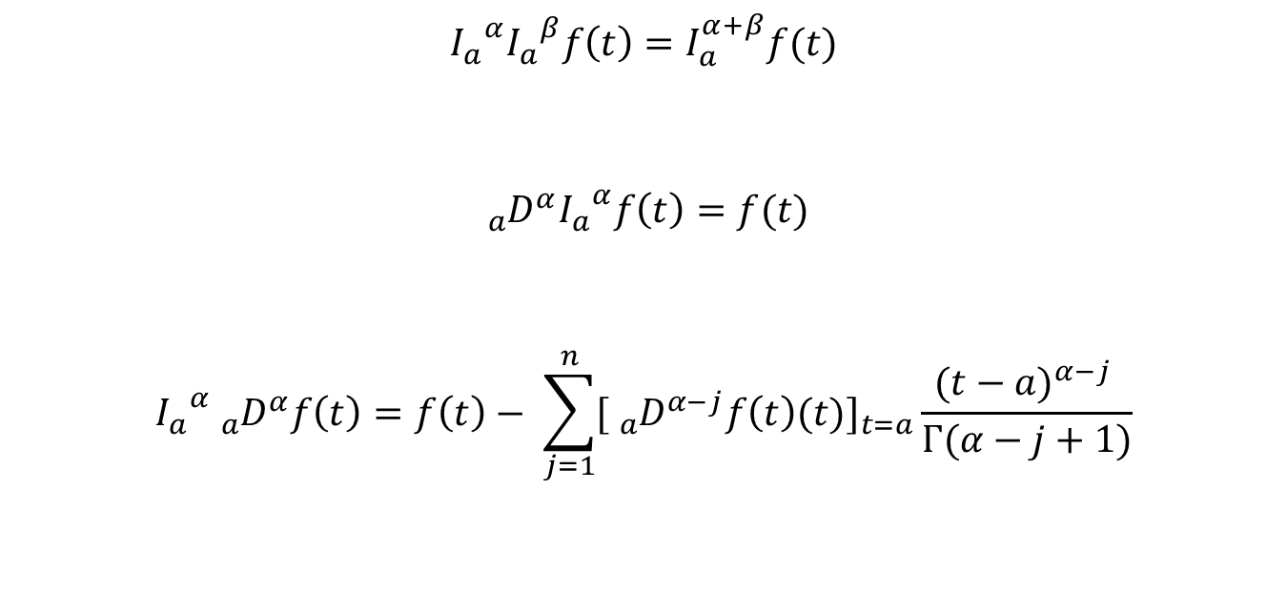
Extended FTC
$${I_{a}}^{α}{I_{a}}^{β}f\left(t\right)=I_{a}^{α+β}f(t)$$
$${{}_{a}^{}D}^{α}{I_{a}}^{α}f\left(t\right)=f(t)$$
$${I_{a}}^{α}{{}_{a}^{}D}^{α}f\left(t\right)=f\left(t\right)− \sum_{j=1}^{n}{[{{}_{a}^{}D}^{α−j}f\left(t\right)(t)}]_{t=a}\frac{{(t−a)}^{α−j} }{Γ(α−j+1)}$$

Slide 37
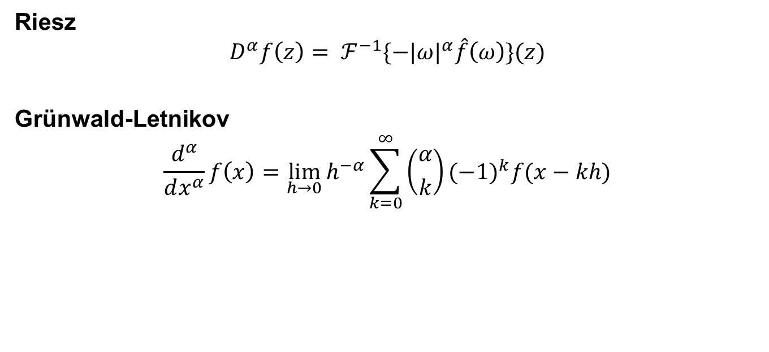
Other Fractional Derivatives
Riesz
$$D^{α}f\left(z\right)= ℱ^{−1}\{−|ω|^{α}\hat{f}\left(ω\right)\}(z)$$
Grünwald-Letnikov
$$\frac{d^{α}}{dx^{α}}f\left(x\right)=\lim_{h\overset{→}{}0}{h^{−α}\sum_{k=0}^{∞}{\left({α \atop k}\right)(−1)^{k}f(x−kh)}}$$

